Slide 1
ESPERANZA ~ HOPE
Y el Dios de esperanza os llene de todo gozo y paz en el creer, para que abundéis en esperanza por el poder del Espíritu Santo.
May the God of hope fill you with all joy and peace in believing, so that you may abound in hope by the power of the Holy Spirit.
Romans 15:13

Slide 2
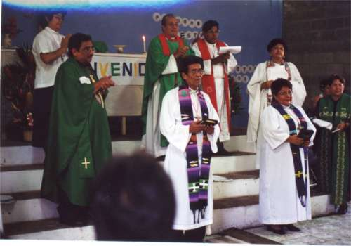
Fe y Esperanza ~ Faith and Hope
During the civil war, the Lutheran Church sheltered refugees at a camp called “Faith and Hope.” Today, this is the site of a church with the same name. In this photo, 2 pastors are being ordained by Bishop Gomez.

Slide 3
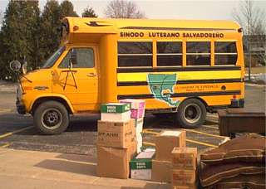
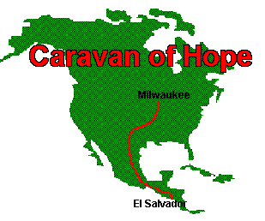
Caravan of Hope
A school bus filled with tools, supplies for emergency shelter, and items to support small businesses traveled down the Pan-American highway to El Salvador in response to the earthquakes of January & February, 2001.

Slide 4
“These people shake us up because they bring home to us that things are much worse in the world than we dared to imagine…if we allow them to share their suffering with us, they communicate some of their hope to us as well…and we recognize that there is something going on in the world that is more wonderful than we dared to imagine.” Dean Brackley S.J.
The Container of Hope
October 2004 – July 2005
Notes:
Introduce myself
Greetings from brothers and sisters at St. John’s in Brookfield, saludos de los hermanos y hermanas de Mi Buen Jesus, y Los Heroes de la Fe, Pastores Julio y Santiago, y Obispo Medardo Gomez.
A blessing to share story of Contenedor de Esperanza, the Container of Hope
Bible texts: Parable of Mustard seed
Good example…tiny growing into something so big. Jesus tells us the kingdom of heaven is like a mustard seed that after it is planted it grows into a huge bush. That seed is like a little bit of love, and when you plant it in someone’s heart by sharing it, it just gets bigger and bigger …
That is the story of the Container of Hope. A little mustard seed of love was planted by God into the heart of a boy and a pastor, and it grew and grew.

Slide 5
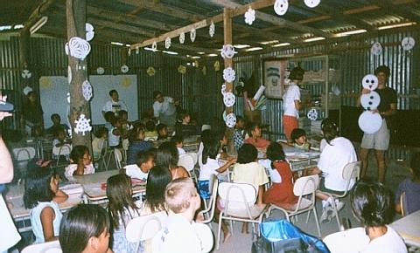
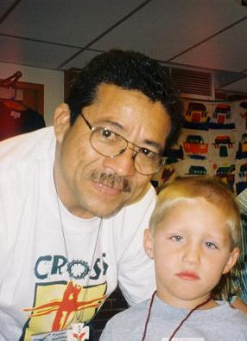
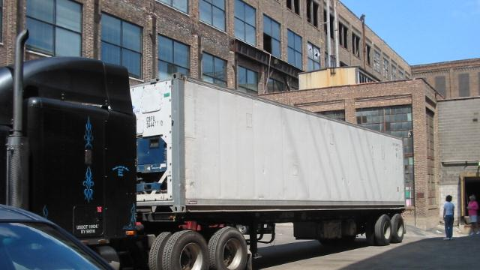
Notes:
(Book) This is the seed God planted. God used a visit to the school in Los Heroes in December of 2001, a library project St. John’s did for Ghana in 2002, and a visit from Pastor Santiago to St. John’s Vacation Bible School in 2004 to plant an idea in Jason’s head.

Slide 6
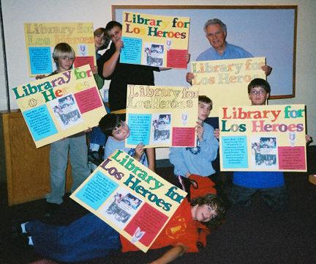
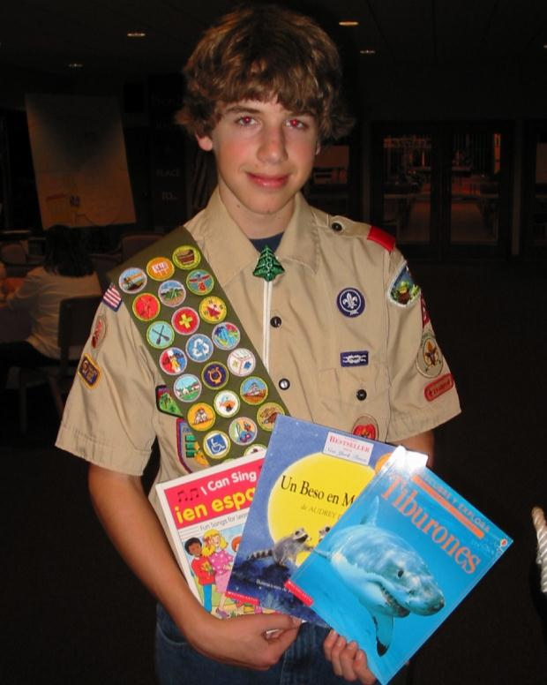
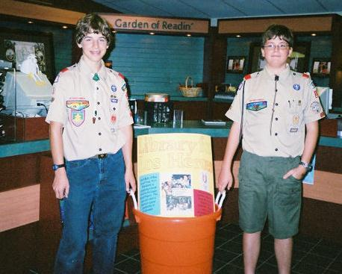
Notes:
Why not build a library in Los Heroes as his Eagle Scout project?
At our kitchen table, in August of 2004, the seed for the Container of Hope project was planted. Jason wrote up a proposal for his Eagle project. The books would only fill a corner of a forty-foot shipping container, so we consulted with Bishop Gomez to see what we might collect to fill The Container of Hope.
Jason’s proposal was the mustard seed that grew into a project to help with educational and medical needs, to establish and support self-sustaining businesses in poor communities, and to develop sports teams and other programs for youth in response to increasing gang violence. An anonymous benefactor accepted the proposal and donated the shipping costs.

Slide 7
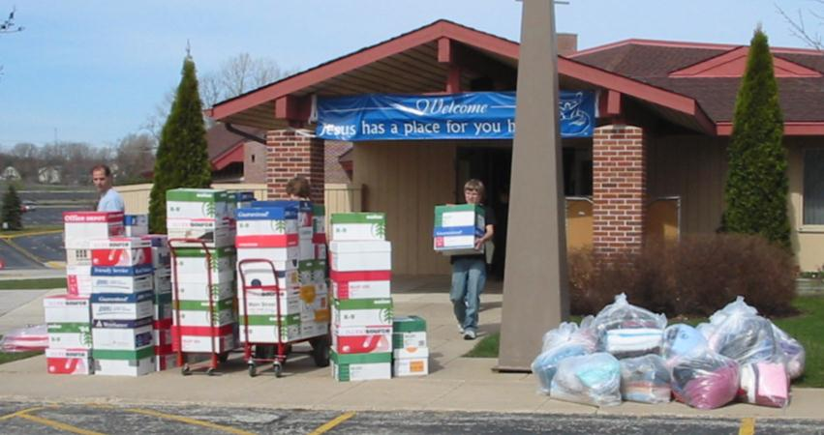
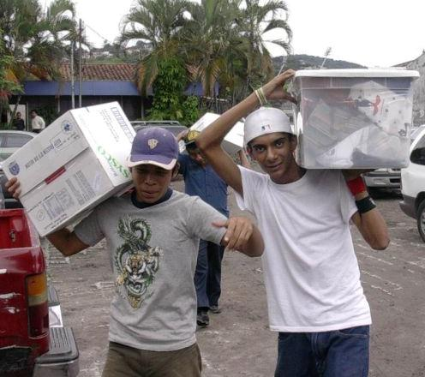
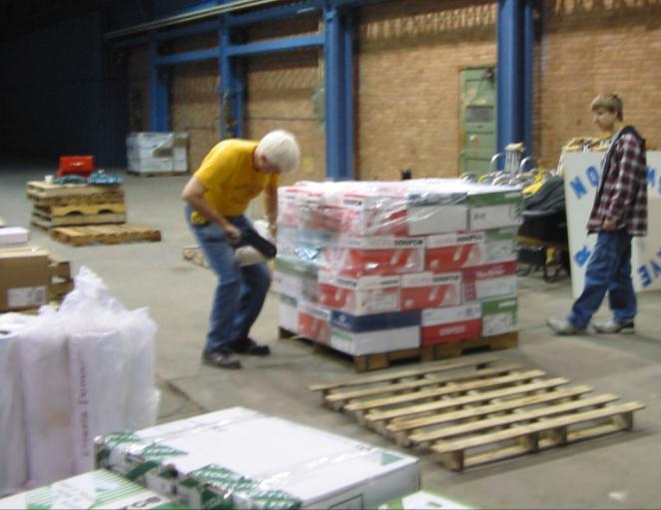
Fabric
Notes:
Beginning in October, we started collecting fabric and sewing machines.

Slide 8
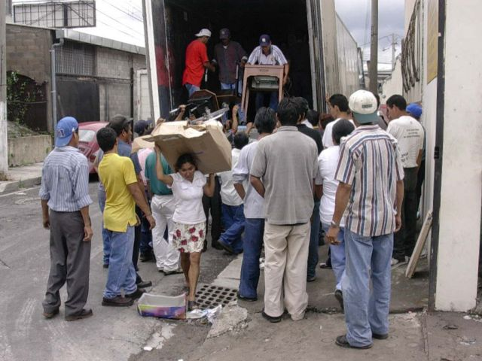
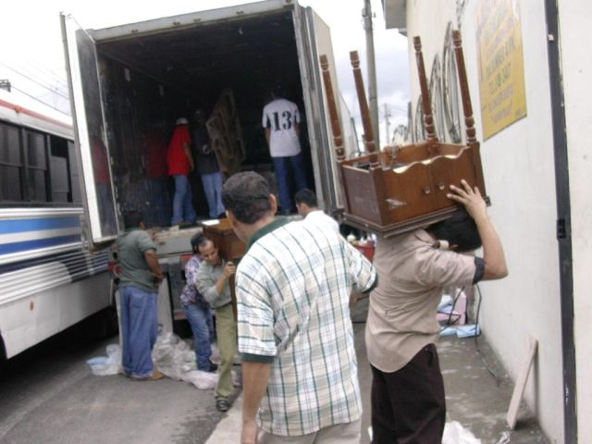
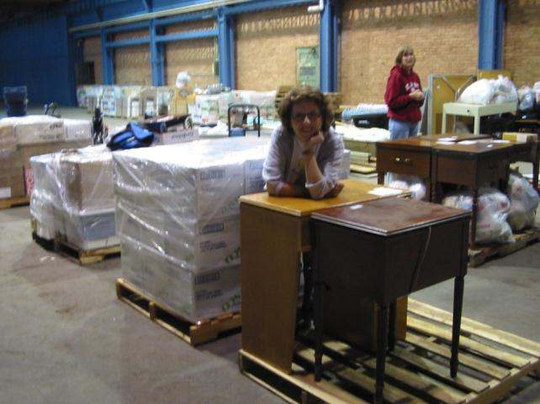
Sewing Machines
Notes:
Container Diaries, May 9, 2005
My mom lives in Oconomowoc, so I see her pretty often. We have casually talked about the container project on and off for months now. The other day, we were on the phone talking about the sewing machines. When I told her that we had more than 30 machines, she asked where we had gotten them all. I said, “ Well a number of them have come from the older ladies in our church who can’t see to sew very well any more.” She said, “I have a machine and I don’t sew anymore.” I asked if she would like to give her machine, and she asked me if I was calling her a little old lady. We had a good laugh about that, and my husband ended up going to get her machine.
In thinking about this little personal experience, I am wondering why I didn’t think to ask my mom for her machine months ago. Isn’t it funny how we sometimes forget to ask for help from those who are closest to us…our families? Now my grandma’s sewing machine has also been donated. It is a treasured gift, given by my aunt. My grandma was famous for her sewing! Grandma’s machine carries years of matching jumpers that my sister and I wore to school and about a million house dresses that Grandma made for herself with pockets and zippers.
Every sewing machine carries a story. I like to think about the Salvadoran women, who like my grandma, my mom, will bend their heads over their sewing machines, joining their family stories to ours.

Slide 9
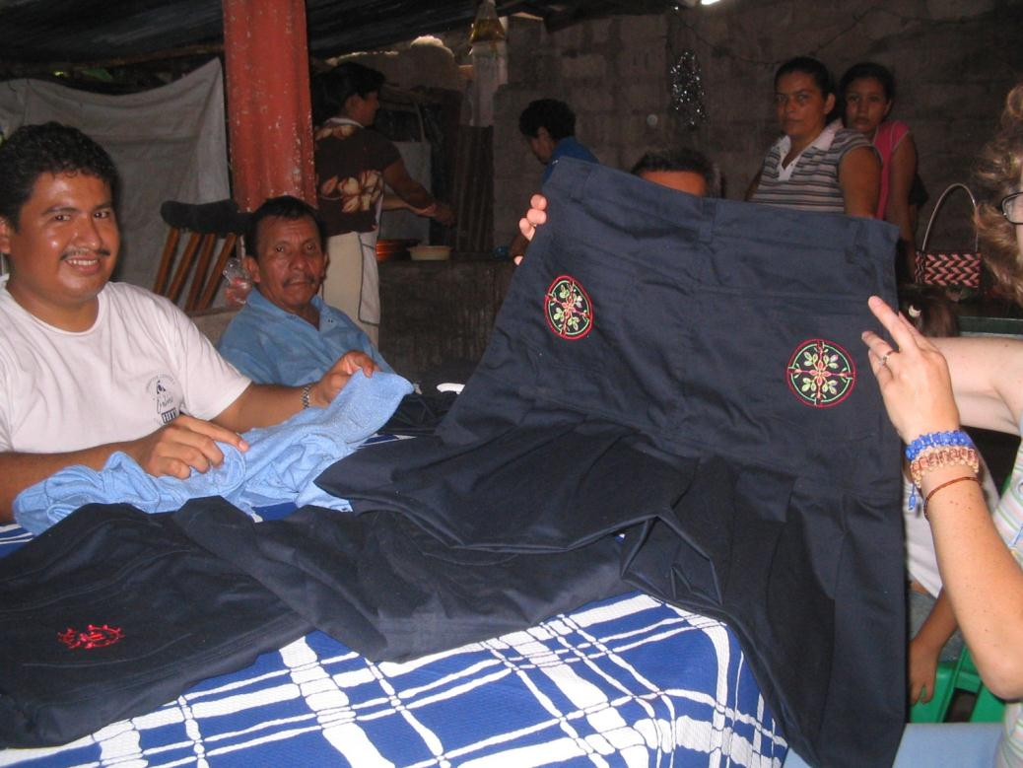
Jorge shows us the latest design
Notes:
Start or support 14 sewing cooperatives

Slide 10
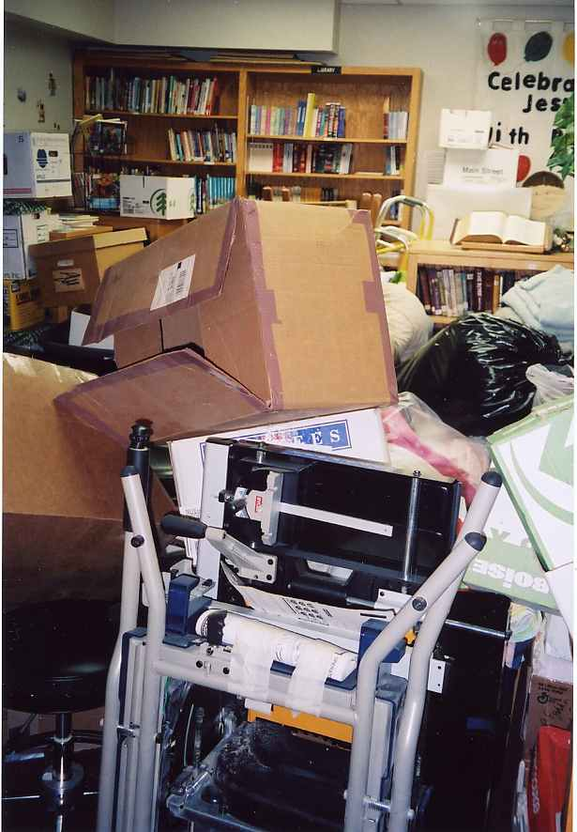
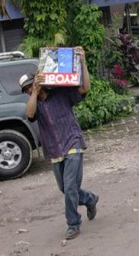
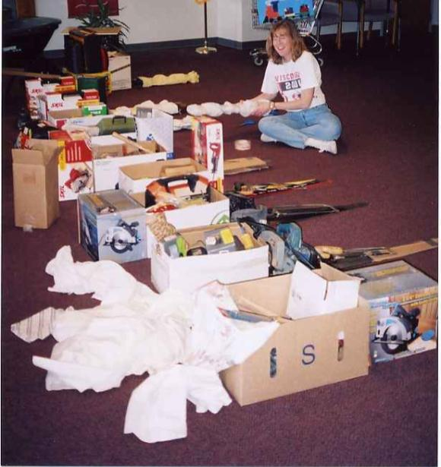
Tools

Slide 11
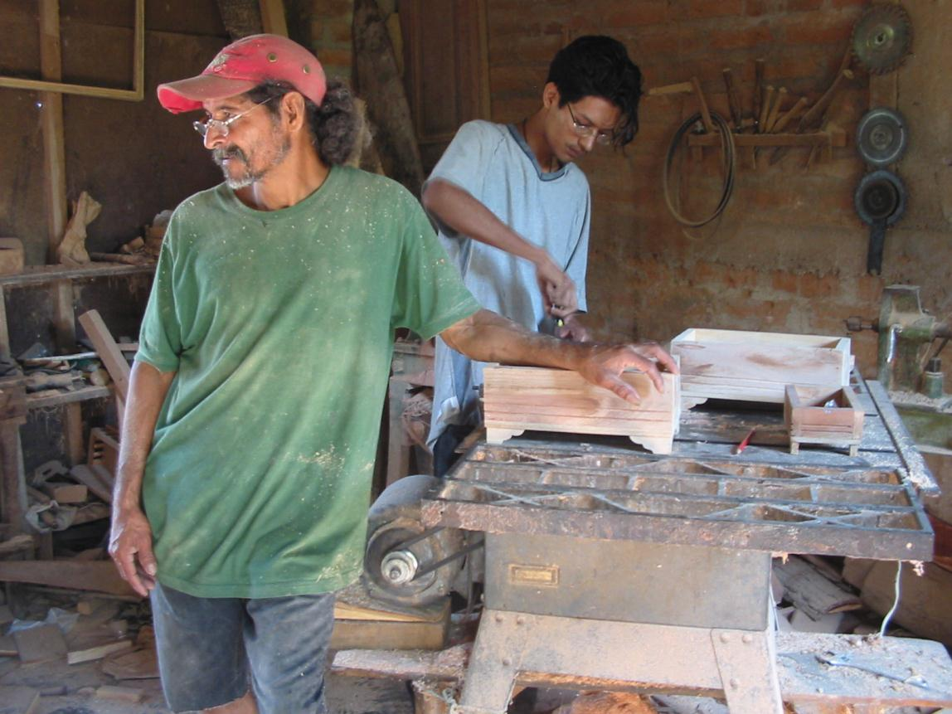
Notes:
Woodworking shop in Los Heroes
Luis
His mentor…who was afraid of the camera

Slide 12
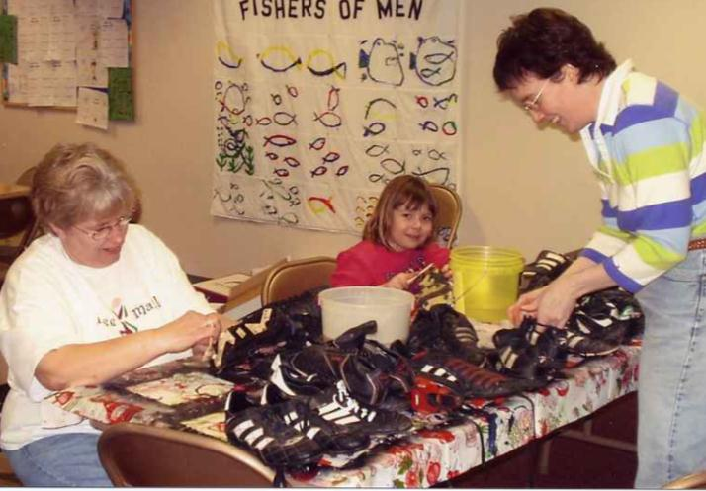
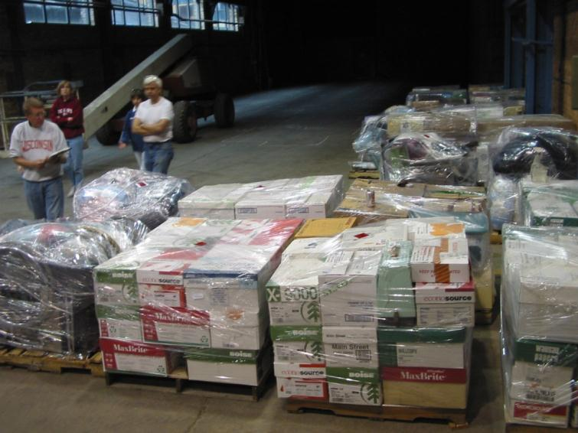
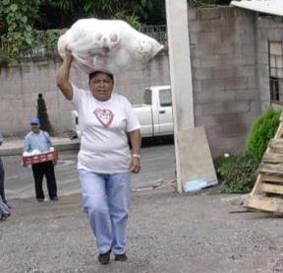
Sports Equipment
Notes:
Started with VBS: SonGames
Park and Rec: Waukesha, Wales, Pewaukee
Wauwatosa Little League
Area high schools
8th grader at our church…buy a jersey challenge….6 teams

Slide 13
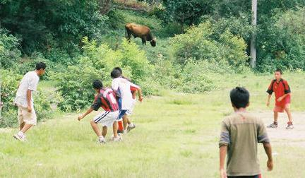
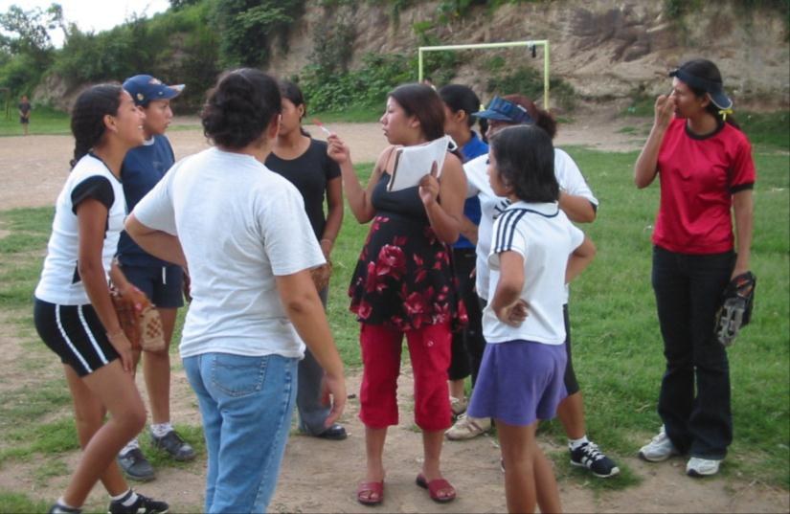
Boys’ Soccer
Girls’ Softball

Slide 14
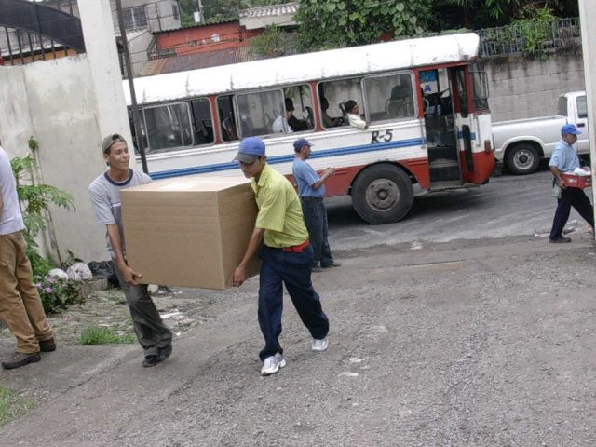
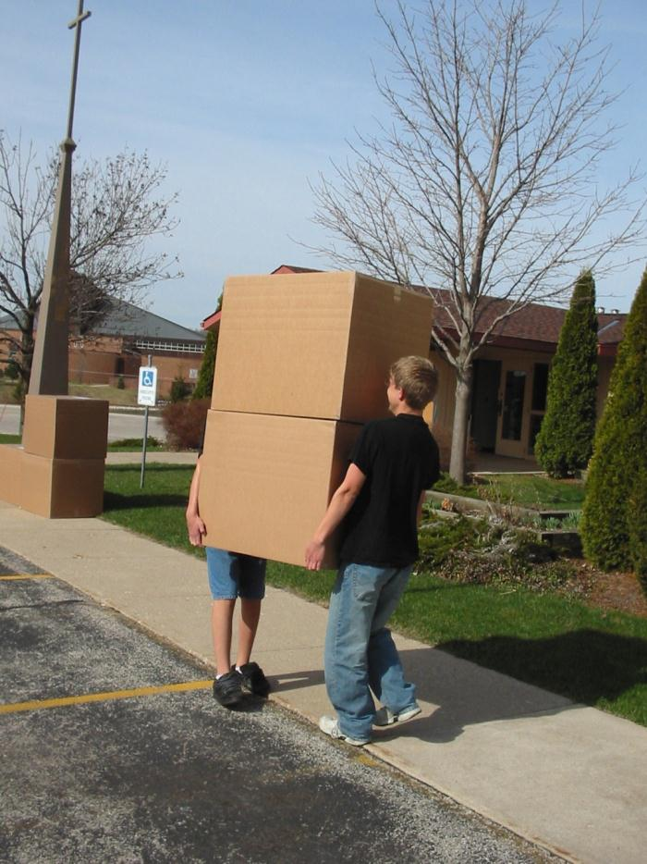
Computers
Notes:
20 computers from ELCA for university

Slide 15
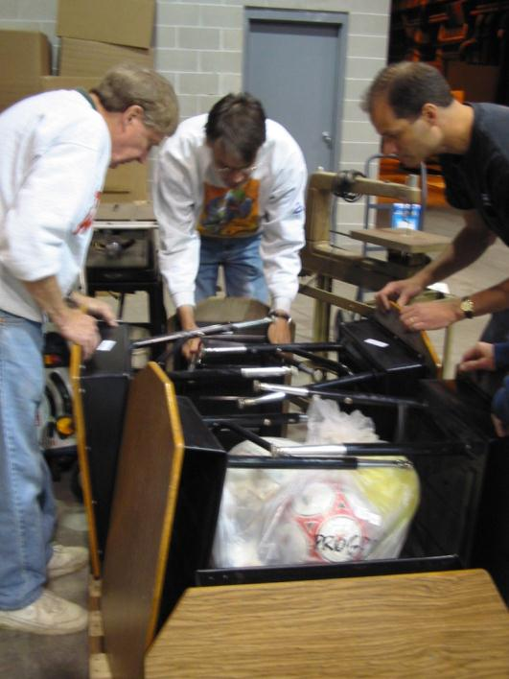
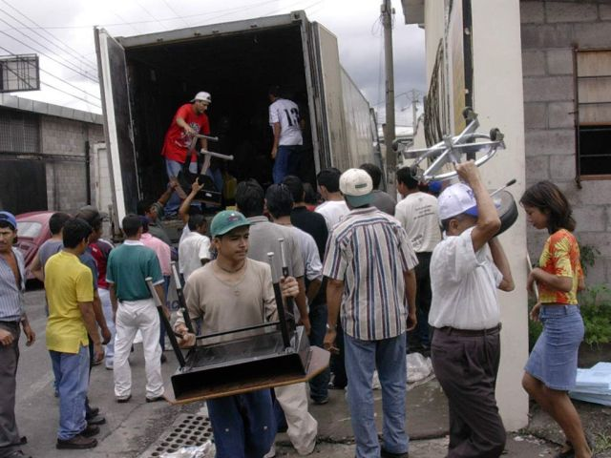
School Desks
Notes:
Elmbrook school district

Slide 16
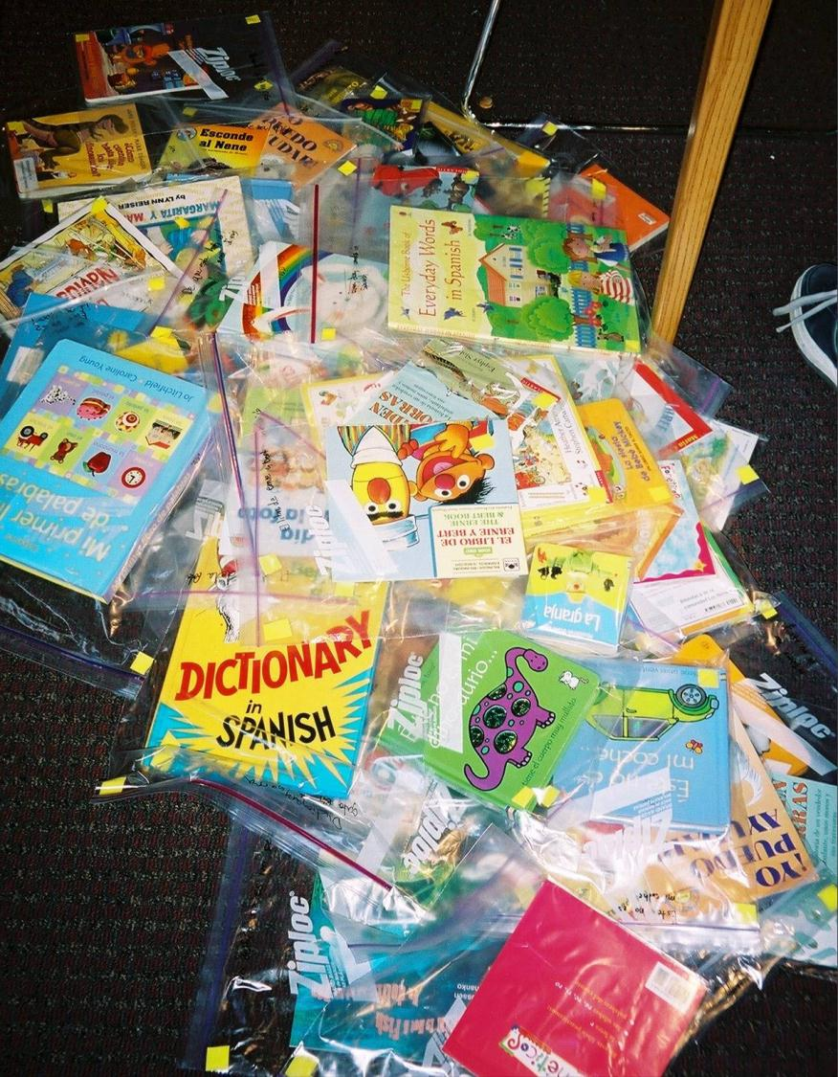
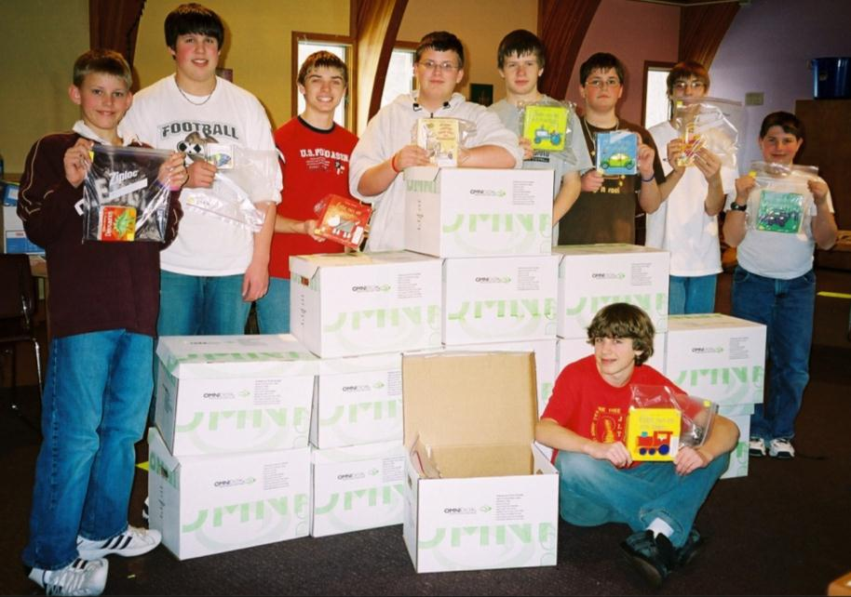
Library Books
Notes:
Container Diaries Tuesday May 31, 2005
Remember how this project began in August as a kitchen-table conversation between Jason and Pastor Santiago---just a crazy idea about a library---
Now all these months later, we wonder…
How did an Eagle Scout project to build a library in a small Salvadoran community grow into a 40-foot shipping container filled with supplies for sewing cooperatives, woodworking shops, an appliance repair shop, midwives, schools, a medical clinic, a homeless shelter, Sunday School teachers, pastors, farmers, church offices, the Lutheran University, a program to discourage weapons, and youth sports programs?
How did a little hill of 800 Spanish books turn into a mountain of sewing machines, table saws, midwife kits, baby clothes, school desks, crutches, wheel chairs, eyeglasses, bedding, Bibles, teaching materials, boats, school supplies, computers, stuffed animals, soccer, baseball and basketball equipment?
How? Pastor Santiago has know the answer from the beginning. “Jesus has chosen this 14-year-old-boy for a miracle, just as he chose the boy with the two loaves and the five fish. Jesus is working a miracle of hope among his people.” We are witnesses to this miracle.

Slide 17
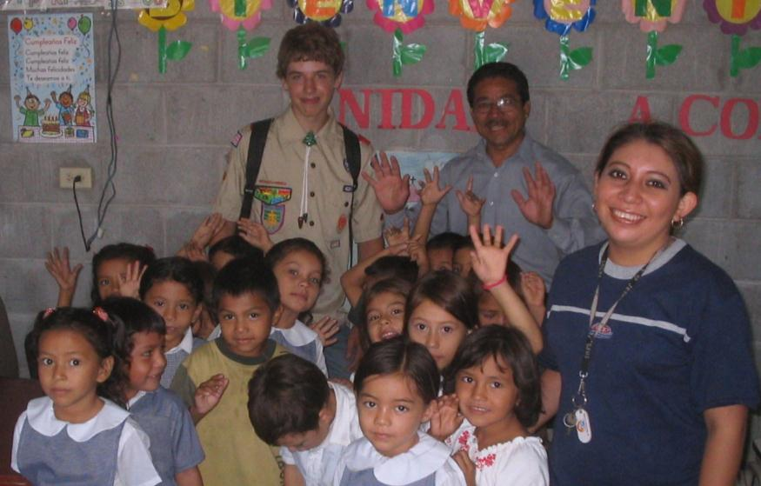
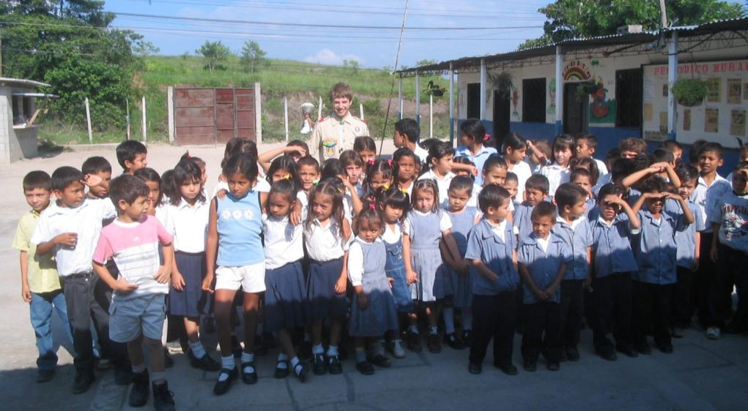
Gracias por la biblioteca, Javier

Slide 18
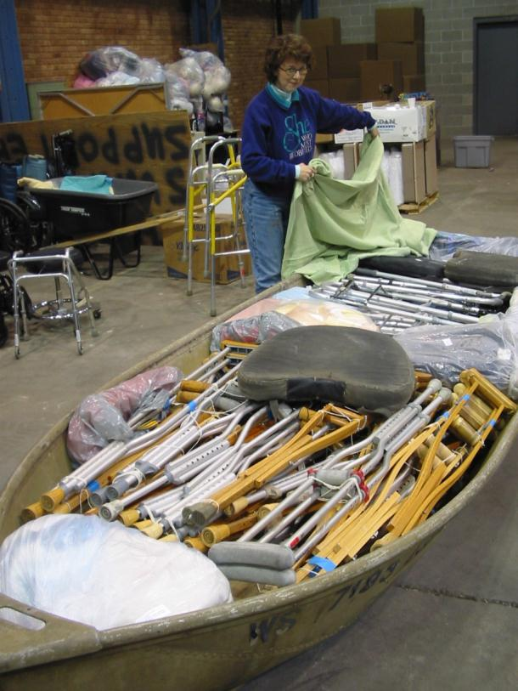
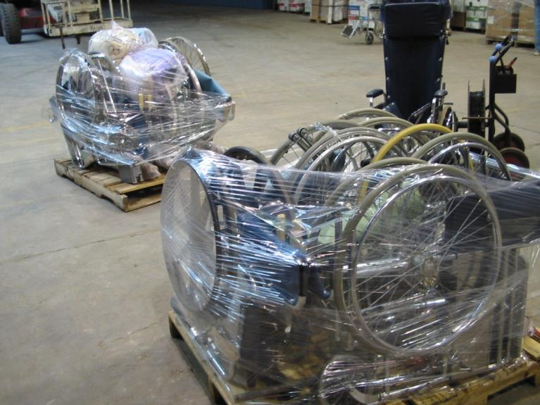
Medical Equipment

Slide 19
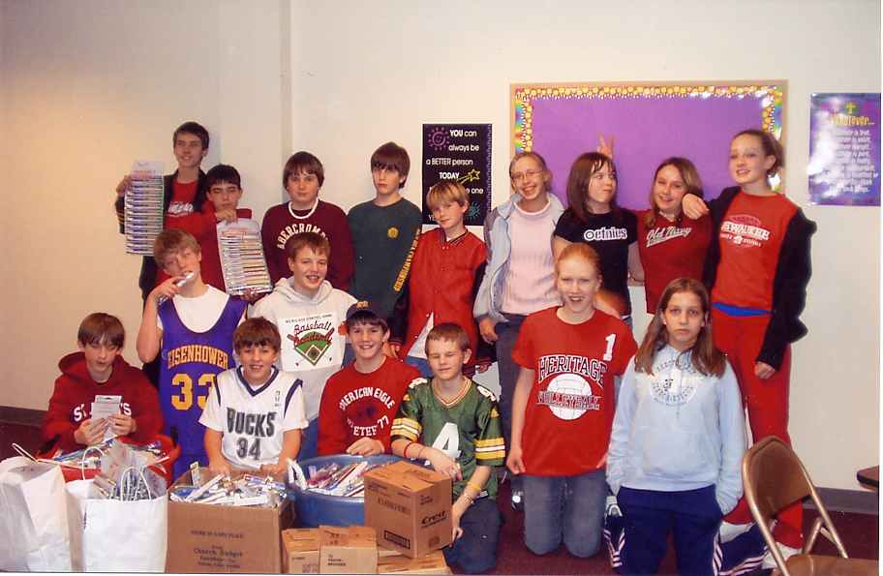
The great toothbrush challenge…
Notes:
3442 toothbrushes

Slide 20
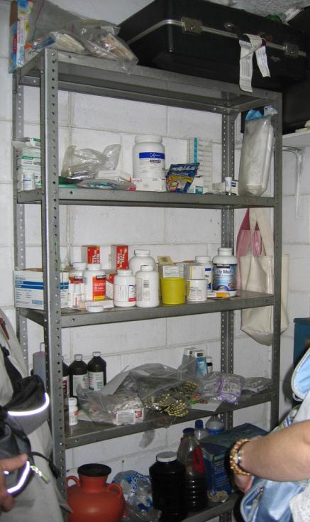
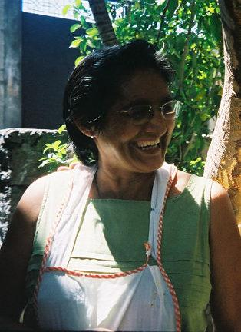
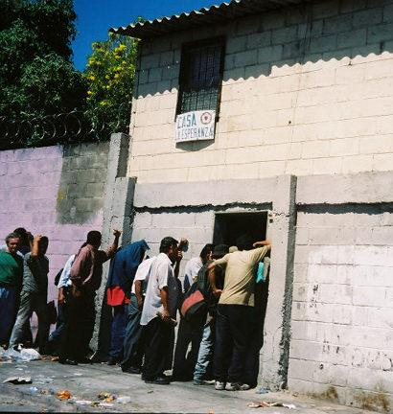
Casa Esperanza
Notes:
Hope House
Homeless shelter
Sewing
Woodworking
Computer
Clinic

Slide 21
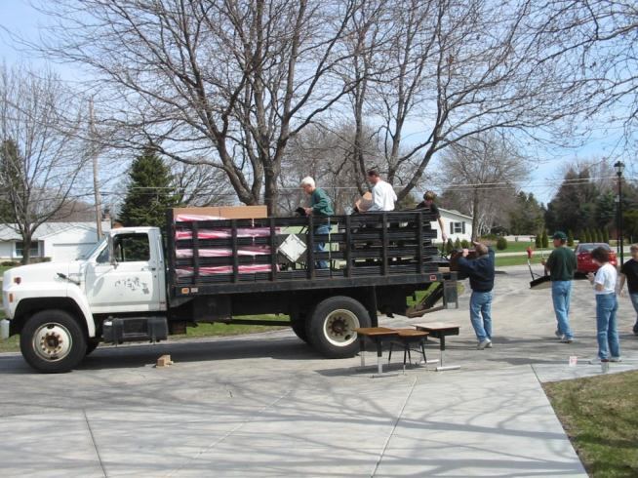
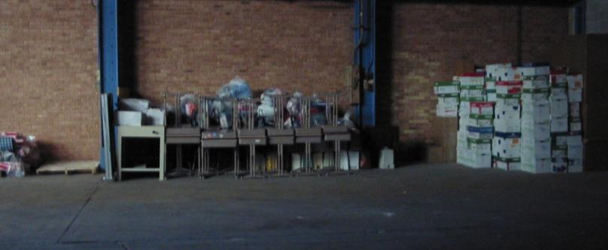
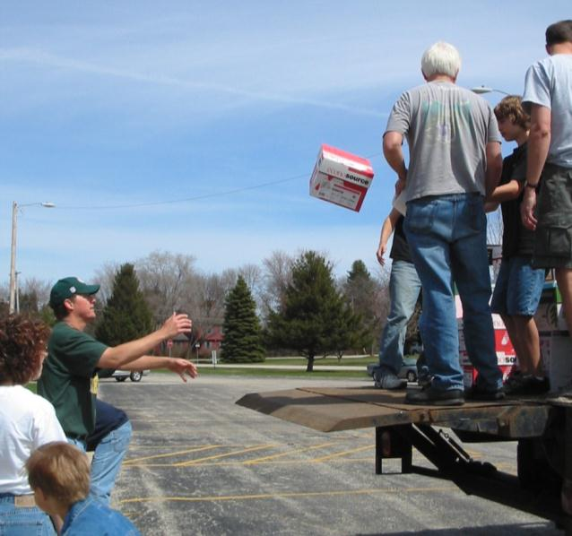
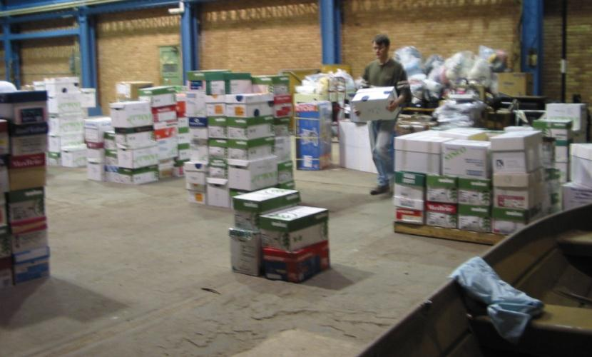
One box at a time…

Slide 22
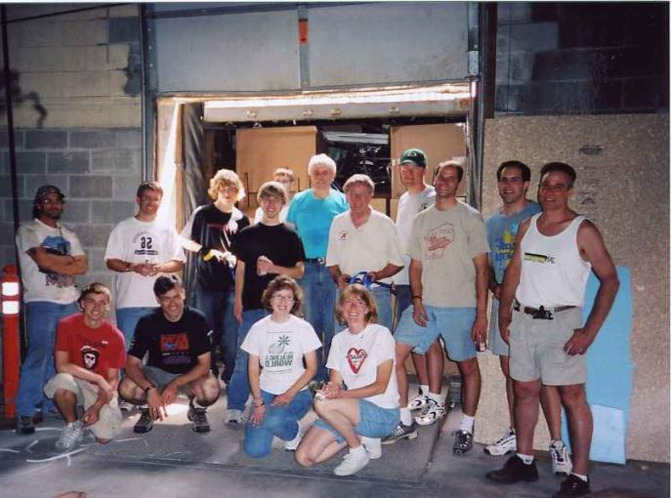
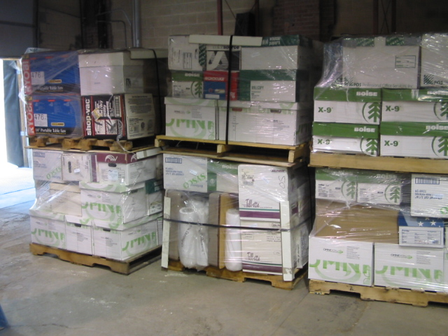
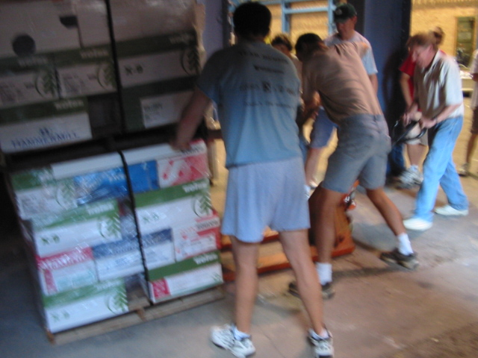
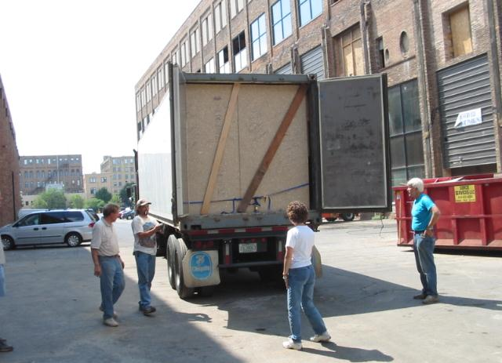
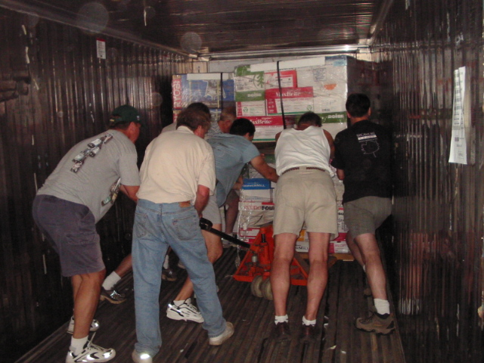
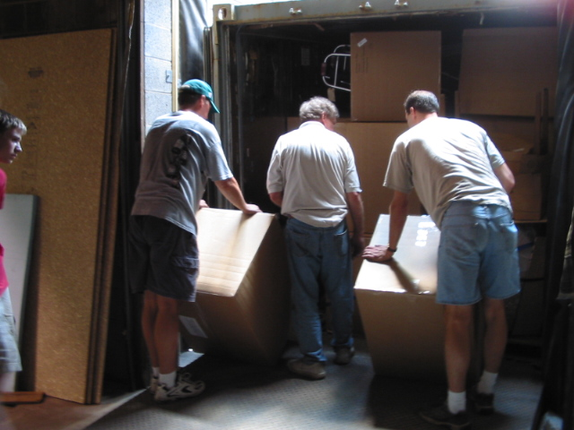
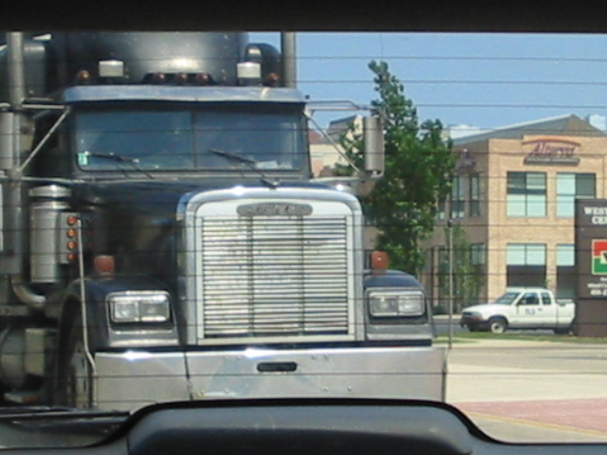
Notes:
Container Diaries June 14
Because we were rookies, we didn’t think to ask the trucking company about sealing the container. This is an important little security device that shows that the container has not been opened en route. Steve (our driver) said he could maybe buy one at the nearest truck stop. Well, luckily I know exactly where that was, because I had just been there!! The truck followed me to the stop. In the time it took me to walk over to the truck side of the lot, Steve had received a seal as a gift from a fellow trucker, who was wearing a t-shirt with a verse from Colossians on it. I sent Steve off with a blessing and a little hug.
This project has been filled with little coincidences . .little miracles…which we believe have been signs from God along the way. We may never see Steve again…but we will always remember him. And I think he will remember the most unusual load he ever carried, too.

Slide 23
ESPERANZA ~ HOPE
Y el Dios de esperanza os llene de todo gozo y paz en el creer, para que abundéis en esperanza por el poder del Espíritu Santo.
May the God of hope fill you with all joy and peace in believing, so that you may abound in hope by the power of the Holy Spirit.
Romans 15:13

